Slide 1
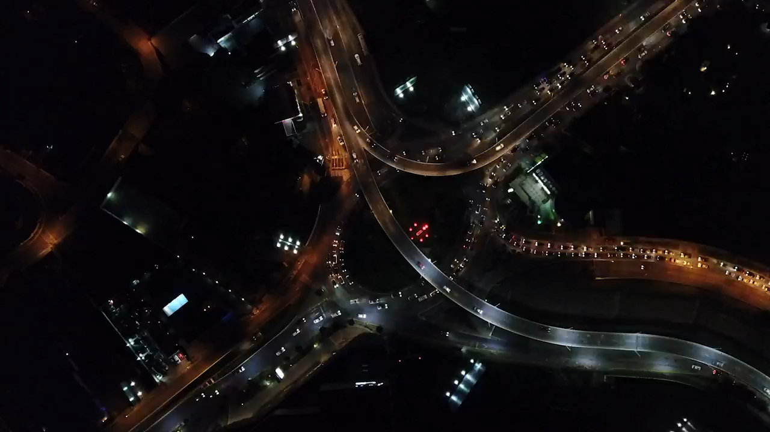
Annual Average daily traffic
Team Members:
Meghna Pal (50475251)
Harshitha Bommakanti (50475216)
Gopireddy Guru Kavya (50485454)

Slide 2
SCOPE OF PROJECT
Roads and highways require constant monitoring over time to keep track of the volume of traffic passing certain streets, so as to figure out the steps required to increase the efficiency of the road.
This also helps in calculating the optimum time for each traffic signal.
The AADT is basically a critical measure in telling how busy a road is, and therefore plays an important road in Urban planning, taxation etc.
The data used in this project was live data taken from the Buffalo government website: https://data.buffalony.gov/

Slide 3
DATABASE FORMATION AND SCHEMA
The data extracted from the website was normalized into a database with 5 tables:
County – CountyID, County
Municipality – MunicipalityID, Municipality, CountyID
Local – LocalID, CountyID, MunicipalityID
Roads – LocalID, Road_name, Start_point, End_point
AADT – LocalID, Year, AADT
Our data frame consisted of LocalID, County, Municipality, Road_name, Start_point, End_point, Year and AADT

Slide 4
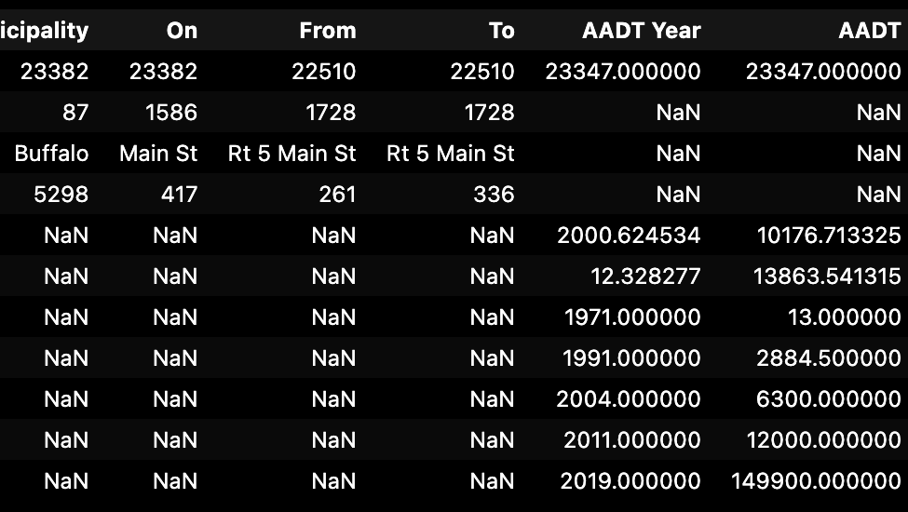
EXPLORATORY DATA ANALYSIS
Analyzed the data description and information
Removed duplicate values
Cleaned data – eg. converted ‘object’ type to ‘int’ type
Dropped records based on project scope
Visualization of data to find distribution across various aspects
Performed One-Hot Encoding for K-means Clustering

Slide 5
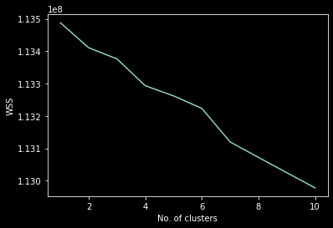
K-Means CLUSTERING
K-means clustering was performed on the data after scaling.
The optimum number of clusters is chosen based on the WSS plot
# of clusters chosen = 4 (elbow point)
The final model was built using these 4 clusters and silhouette scores and widths were calculated to check the accuracy on the model

Slide 6
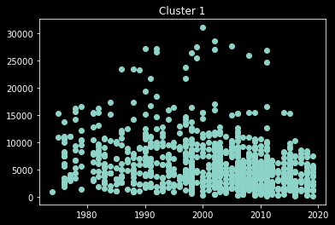
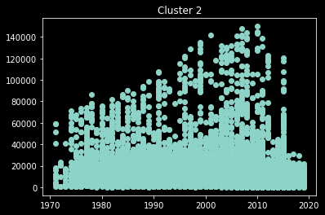
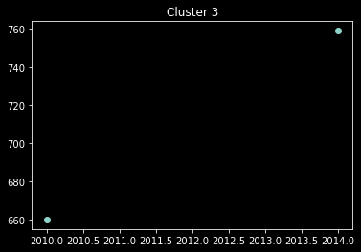
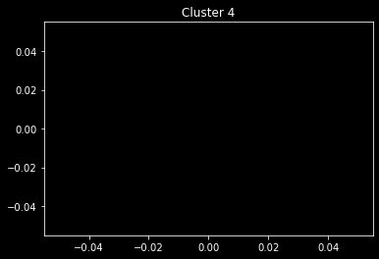
AADT_Year vs AADT graphs

Slide 7
As observed, there are no points in the 4th cluster, so essentially there are only 3 clusters.
Trial and error method was then used to find optimum number of clusters but 4 turned out to be the best.
The clusters were then used to analyze the kind of roads it consisted, the frequency of different roads, County and Municipality etc., all done across the year in which the record was made.
With the current model, number of records in each cluster is as follows:
1 – 1073
2 – 21605
3 – 2

Slide 8
FUTURE SCOPE OF PROJECT
If the geographical points of these roads are given, then analysis can be made to see roads that are parallel to the ones that are extremely busy and the load can be reduced by either making the street one way or diverting part of the crowd to another such street.
Junctions, if mentioned, would also give and idea of the busy-ness of the road as there will be more vehicles crossing.
The dimensions of the roads would give a better idea of how big a road is and would help us understand whether to expand the road or create a diversion.
With more knowledge about a street being One-way or Two-way we would be able to understand the state of the road better.
The kind of vehicles, such as cars or trucks, also plays an important part in understanding the approach towards analyzing the situation of the road.
If we can get the AADT of a road over time, a predictive time-series model can be built to analyze and predict the future load on the road and plan accordingly.

Slide 9
THE END

